Slide 1

NOVEMBER 22, 2020
VOICE-BASED TRANSPORT ENQUIRY SYSTEM
Presented by Zeinep Kuanyshova

Slide 2
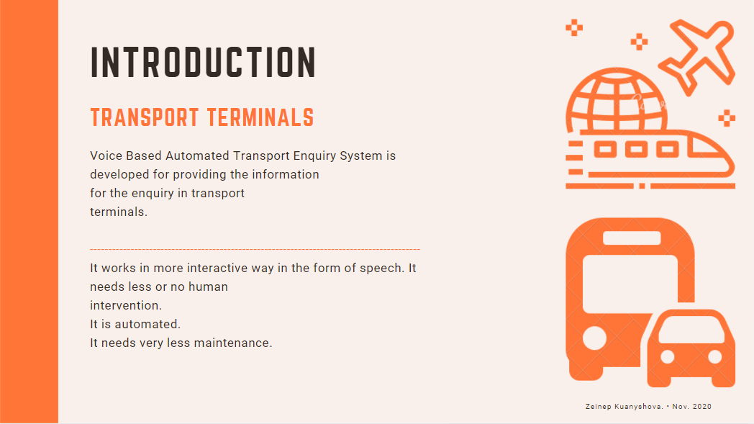

Slide 3
FEASIBILITY STUDY
FOCUSED ON
1
2
3
What is the users needs and how does the framework meet them?
What resources are accessible for given frameworks?
What are the strtucture affect of the system on the organization and how it fit with the Framework plans?
Faver, Stone & Co. • Aug. 2020

Slide 4
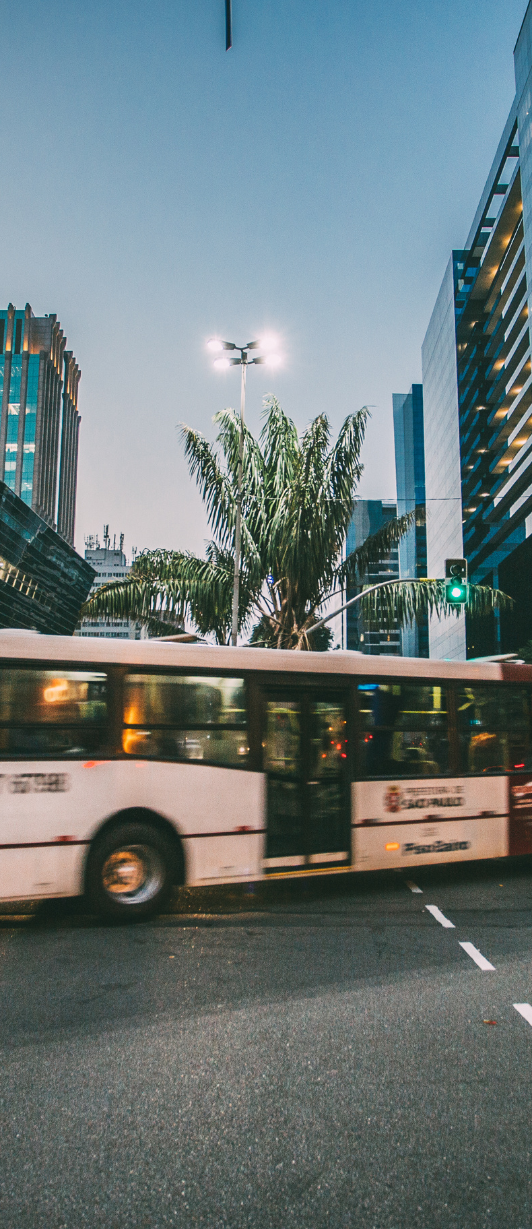
DATABASE information
Extended function
1) Profitability
2) Does not require any additional hardware components other than a microphone (mouse).
3) The same technology can be used in other fields such as hotels, etc.
Benefits
1) Anyone can use only voice knowledge.
2) 24 hours of use with efficiency and better performance.
3) Ease of interaction and the ability to get as much information as needed.
4) People with disabilities can also use the unlike touch screen.
Disadvantages
Doesn’t work properly if there is interface
Requires preliminary preparation of the voice
Zeinep Kuanyshova • Nov. 2020

Slide 5
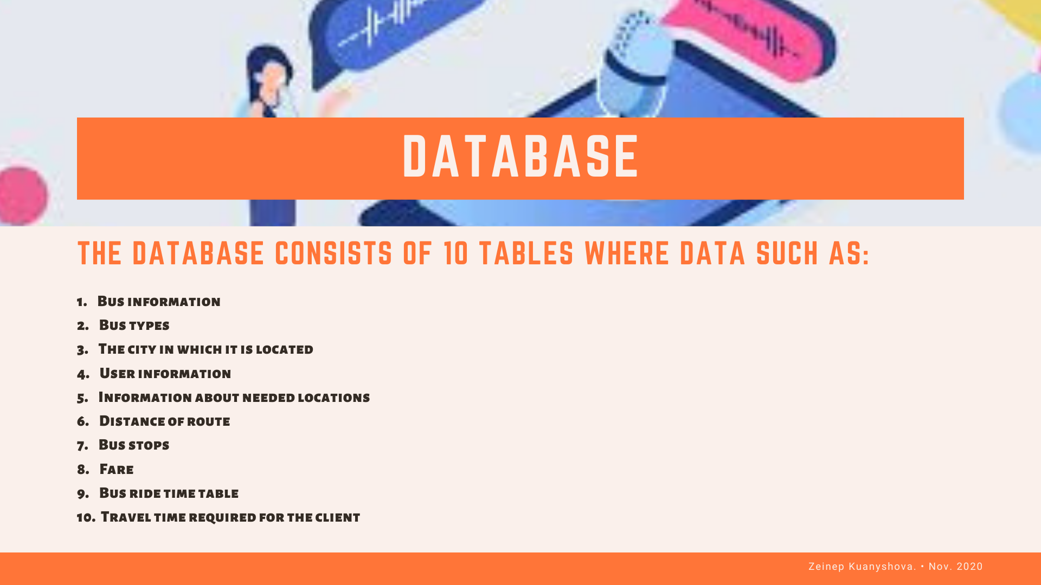

Slide 6
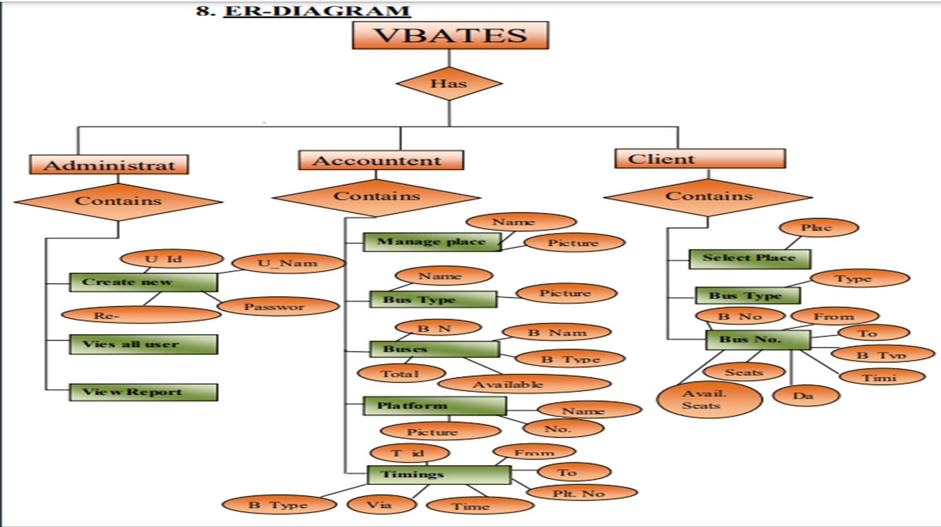
ER DIAGRAM

Slide 7
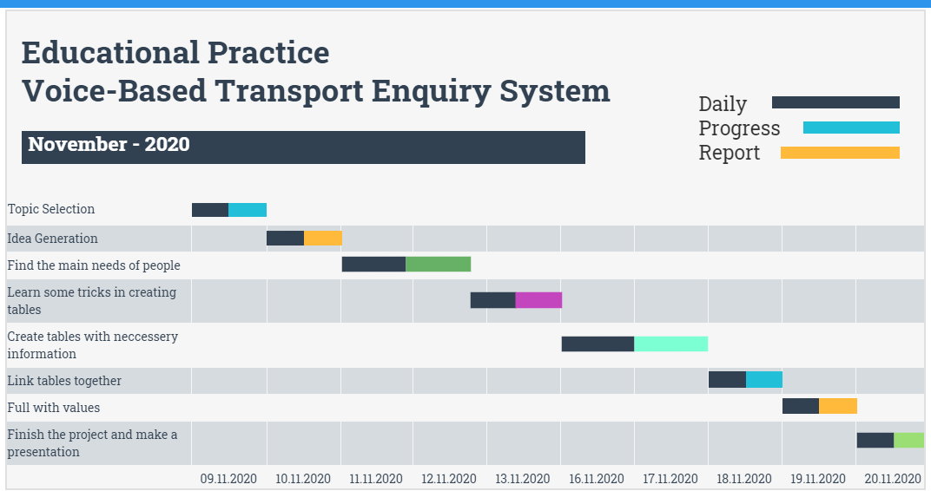

Slide 8
